Slide 1
Tia Collins Maria Victoria Gonzalez Burcet Adrian Skrzypczak

Slide 2
A worldwide company which sense knowledge

Slide 4
A worldwide market

Slide 5
”Wikimedia is a global movement whose mission is to bring free educational content to the world.”

Slide 6
“Through various projects and the support structure of the non-profit Wikimedia Foundation, Wikimedia strives to bring about a world in which every single human being can freely share in the sum of all knowledge.”

Slide 7
A group of Wikimedians who promote free access to, and re-use of, human knowledge.
Take a stance on regulation relating to open access and copyright.
Three projects:
1. Public Domain for Public Works.
2. European Freedom of Panorama.
3. Free Use of Orphan Works.

Slide 8
# of persons in lobbying
TOTAL: 6
5 persons ---- 100% (full time)
1 person ---- 50% (part time)

Slide 9
Distribution of work
2 people responsible for the EU activities.
3 person responsible for German activities but also partly helping out with EU level activities.
1 half-time person working on specific projects/dossiers.
6 people that spend at least some paid hours every month on this.
About 30 volunteers with varying degrees of commitment

Slide 10
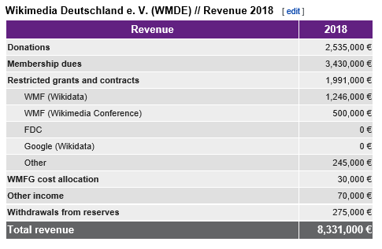
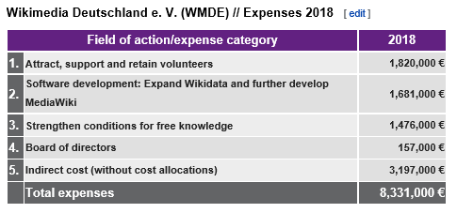
Lobbying budget estimate
Total budget: €8,331,000
Annual costs of activities: €100,000 - €199,999
No financing received from the EU commission or from public financing
Funding gained through donations and contributions

Slide 11
Lobbying objectives
Public goals
A Copyright Reform
Ensure the definition of the PSI directive remains open
Terrorism Regulation program
Strategic goals
Have more collaborations with free rights organisations
Guide politicians to the right committees
Improve public opinion on free knowledge movement

Slide 12
Actions and Success of the Wikimedia’s lobby
Few examples
Fight against hate speech on the Internet (coming soon)
Combating Online Terrorist Content (2018)
European reform of copyright (2018)
Fight against the manipulation of information (2018)
Priority issue of constitutionality National Domains (2017)
For the free knowledge 2017 ", let us question the candidates in the presidential election! (2017)
Bill for a digital Republic: establishing the freedom of panorama in France (2015)
Open GLAM Report: Recommendations for Open Data and Cultural Content, website (2012)
Amendment Freedom of Panorama (2011)
Assises du Numérique: Status of public works vis-à-vis copyright and related rights (2008)
Member of the Commission Committee of the CSPLA on Internet Providers (2008)

Slide 13
Actions and Success of the Wikimedia’s lobby
Copyright and the freedom of information
Terrorism fight

Slide 14
Meetings

Slide 15
Webliography
Lobying obejctives of Wikimedia​
https://meta.wikimedia.org/wiki/Wikim%C3%A9dia_France/Groupes_de_travail/Groupes_th%C3%A9matiques/Lobbying​
The Free Knowledge Advocacy Group EU on EU policy : ​
https://meta.wikimedia.org/wiki/EU_policy​
Free Knowledge Advocacy Group:​
https://wikimediafoundation.org/tag/free-knowledge-advocacy-group/​
Fight against terrorist content online: ​
https://meta.wikimedia.org/wiki/Wikimédia_France/Lutte_contre_les_contenus_à_caractère_terroriste_en_ligne​
Directive copyright​:
https://meta.wikimedia.org/wiki/Wikimédia_France/Directive_copyright
Wikimedia Movement:
https://fr.wikipedia.org/wiki/Mouvement_Wikim%C3%A9dia
Lobbying objectives
https://meta.wikimedia.org/wiki/EU_policy/Transparency

