Slide 1
Sanofi Lobbying
Hunter Moat, Luis Corona, Laura Bacon, Florian Mariani

Slide 2
Presentation of the company
Created in 1973
Pharmaceutical company
World leader in non-prescription drugs
3rd company in the healthcare sector in terms of sales : 34.46 billion euros in 2018
73% outside of France
Leading French company in terms of R&D

Slide 3
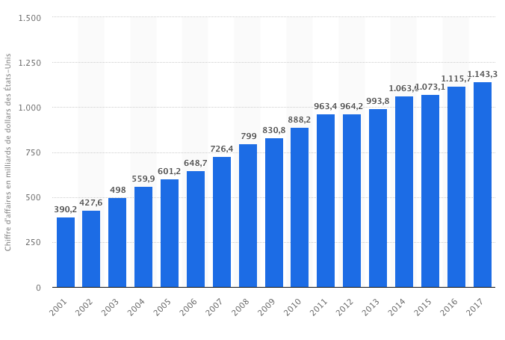
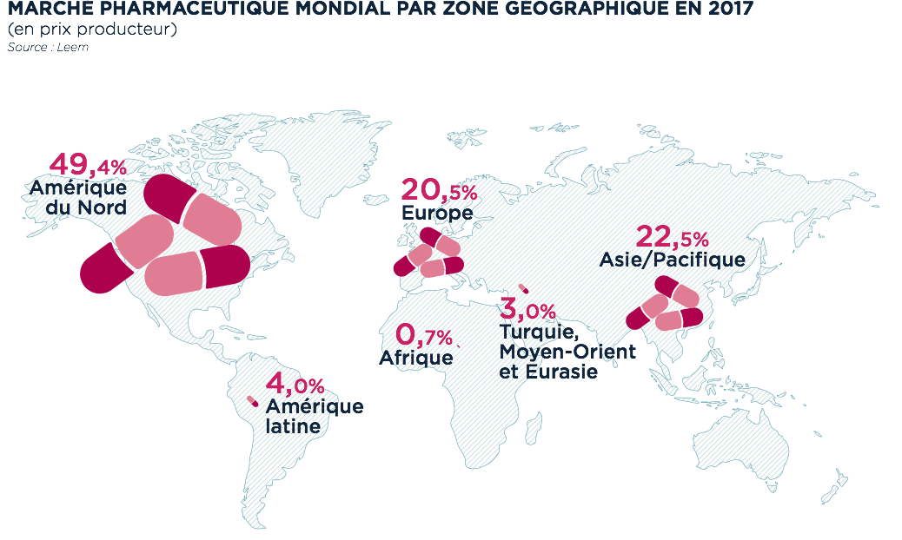
World market

Slide 4
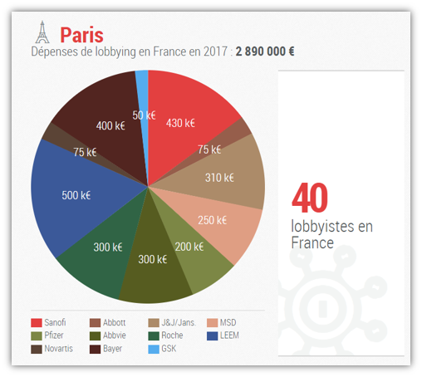
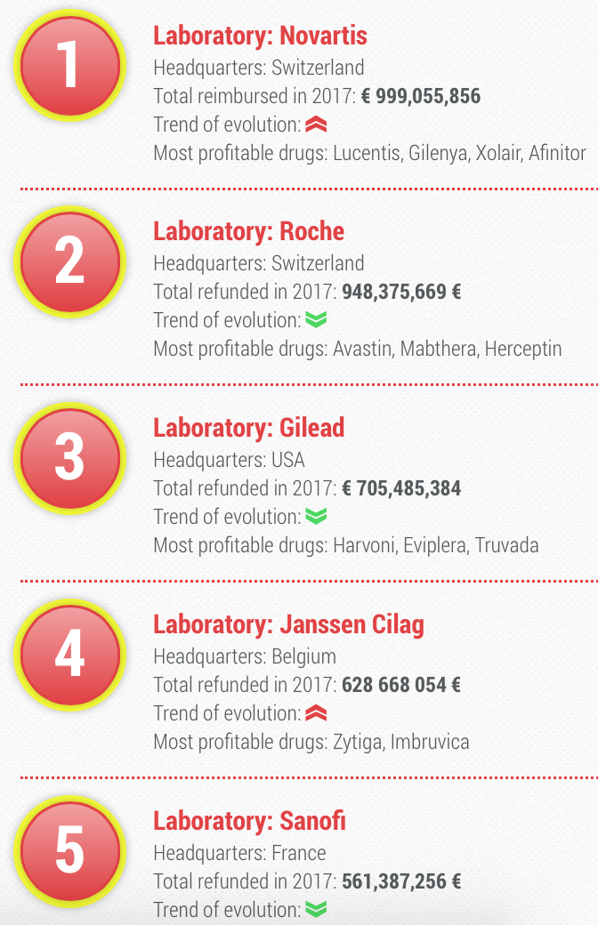
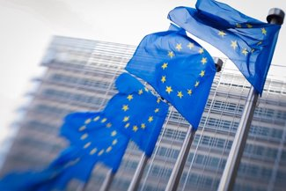
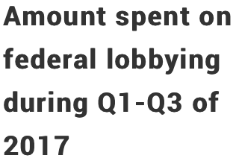
Lobbying objectives
Control drug pricing
Control its market dependency
Paris: social security financing law
Influence regulation in its favour
Notes:
Although Sanofi has many objectives for lobbying, we decided to focus on some of the more prominent ones. To begin, one of the largest goals within Sanofi lobbying rests upon drug pricing. The hard truth is that the prices of prescription drugs nowadays are extortionate, and behind this is the workings of the pharmaceutical industry, with Sanofi being one of the largest contenders. For example, during just Q1 to Q3 in 2017, Sanofi spent nearly $4 Mil under general issues related to drug pricing. The political heat on pharmaceutical manufacturers drug costs has risen substantially recently, and Sanofi (along with many other manufacturers) are spending big money to keep regulation down. Research shows objectives around this focus on keeping drug prices high, opposing new legislation, protecting and expanding existing loopholes, and delaying the implementation of new regulations. Ensuring their ability to raise prices guarantees their ability to drive profits for their shareholders.
Elsewhere, one of Sanofi’s lobbying objectives is to control its market dependency. An example is when in 2007, the FDA (Federal Drug Administration) considered using a cheaper, generic version to that of one of Sanofi’s. Resultingly, in a report by the Senate Finance Committee, Sanofi was accused of paying off doctors to lobby the FDA against generics, and that it paid more than $2.6 Mil over three years to the Society for Hospital Medicine in lieu of fighting off generics. It took over two years for a generic to be considered, and ultimately were defeated, although they saved massive profits during these two years.
Additionally, although when thinking about lobbying we often think of Brussels or Washington, Sanofi has a large interest in Paris. This is because each year, France’s National Assembly reviews and amends the social security financing law, which within determines the amount of spending and reimbursement of prescription drugs set by law. In 2017, Sanofi’s lobbying expenses totalled €430,000 in France, one of the largest spenders. It has been well journaled that the pharmaceutical companies that are the most advantaged in France (that is, who receives the largest refunds) are the ones who spend the most on lobbying, a tactic to securing consumer dependency for its drugs.
It is no different in the US as well for Sanofi, who lobbies to ensure that the drugs are covered by Medicare.
Lastly, which we find as a general overview of its objectives is simply influencing policy making it is favour, which extends to many areas, such as vaccine legislation, research and development policy and intellectual property policy, etcetera.
https://www.cbsnews.com/news/drug-makers-gave-lobbyists-an-xmas-gift-millions-more-to-lobby-obama-administration/ “research and development tax credit”
https://www.citizensforethics.org/a-bitter-pill-how-big-pharma-lobbies-to-keep-prescription-drug-prices-high/ “drug pricing”
https://www.cbsnews.com/news/senators-rail-at-big-pharmas-secretive-lobbying/
https://www.bastamag.net/webdocs/pharmapapers/l-argent-de-l-influence/a-paris-l-influence-ecrasante-des-labos-face-aux-associations-de-patients/ “social security”
https://www.bastamag.net/webdocs/pharmapapers/l-argent-de-l-influence/lobbying-a-paris-bruxelles-et-washington-l-enorme-puissance-de-feu-des-labos/ “social security”

Slide 5
Sanofi meetings
Senate finance committee report 2011
$2.6 Mil paid to Society for Hospital Medicine (Conferences and sponsorship)
$2.3 Mil paid to North American Thrombosis Foundation
$260,000 paid to Duke University medical professor
$25 Mil settlement over bribery in its Kazakhstan and Middle East subsidiaries
¥1.7 million ($277,000) allegedly in bribes to 503 doctors in China 2014
14 meetings with European Commission since 2014
Notes:
As I previously mentioned, in a senate finance committee report, Sanofi was accused of meeting with multiple societies and foundations to influence regulation against generic drug versions. According to the report, the Society for Hospital Medicine received more than $2.6 million over 3 years from Sanofi for sponsorship and conferences. Sanofi urged them to send letters to the FDA questioning the safety of generics. In an internal email, an executive at the society admitted it "has no history of making similar comments to the FDA" and lacked "the expertise and knowledge" to weigh in on the matter. But the society sent two letters anyway. Warning in one, "an untested generic substitution...is not in our patients' best interest". Sanofi also paid $2.3 million to the North American Thrombosis Foundation, which also wrote to the FDA to warn of the "potential for unanticipated adverse events" from generic drugs. Additionally in the same report was evidence showing $260,000 paid to a Duke University medical professor for "speaker/consulting services" to encourage the FDA ‘‘to learn more of the findings and recommendations’’ of a March 28, 2008 ‘‘scientific interchange roundtable’’ in Huntington Beach, CA, which Sanofi paid $190,000 to sponsor.
Sanofi has quite the reputation for bribery, for instance they used schemes which spanned multiple countries and involved bribe payments to government procurement officials and healthcare providers in order to be awarded tenders and to increase prescriptions of its products.
The company allegedly paid ¥1.7 million ($277,000) in bribes to 503 doctors around the country, forking over ¥80 to doctors each time a patient bought its products.
25 Jan 2018 - Lucie Mattera - European patent protection (DG Economics & Tax)
02 Jul 2015 - Commissioner Vytenis Andriukaitis - vaccinations (DG Health)
02 Jul 2015 - Paula Duarte Gaspar - vaccinations (DG Health)
The European Commission doesn't publish information about other lobby meetings with lower-level staff.
Not an exhaustive list
http://www.cardiobrief.org/2011/05/25/senate-report-uncovers-sanofi-attempts-to-stifle-generic-lovenox/
https://www.finance.senate.gov/imo/media/doc/05252011%20Staff%20Report%20on%20Sanofi's%20Strategic%20Use%20of%20Third%20Parties%20to%20Influence%20the%20FDA.pdf
https://lobbyfacts.eu/representative/20c0960ce173429fa1a987cd8b3f688f
https://www.ft.com/content/c552705c-b062-11e8-99ca-68cf89602132

Slide 6
In-house lobbying
Person in charge of EU relations: Ms. Milena Richter, Senior Director European Public Affairs - Head of Brussels Office
Below is a list of Sanofi's current in-house lobbyists with access to EU Parliament
Notes:
Sanofi joined the EU transparency register in 2009, which requires members to disclose information regarding their lobbying and advocacy activities. https://www.sanofi.com/-/media/Project/One-Sanofi-Web/Websites/Global/Sanofi-COM/Home/common/docs/download-center/Lobbying_2018.pdf?la=en&hash=BFFFFCC15AB7E25A5377B675F9BCADE5A05BDE4C
In the European transparency register, Sanofi is registered in section II
This means that their lobbying is done both in-house and through trade/business/professional associations
http://ec.europa.eu/transparencyregister/public/consultation/displaylobbyist.do?id=61291462764-77

Slide 7
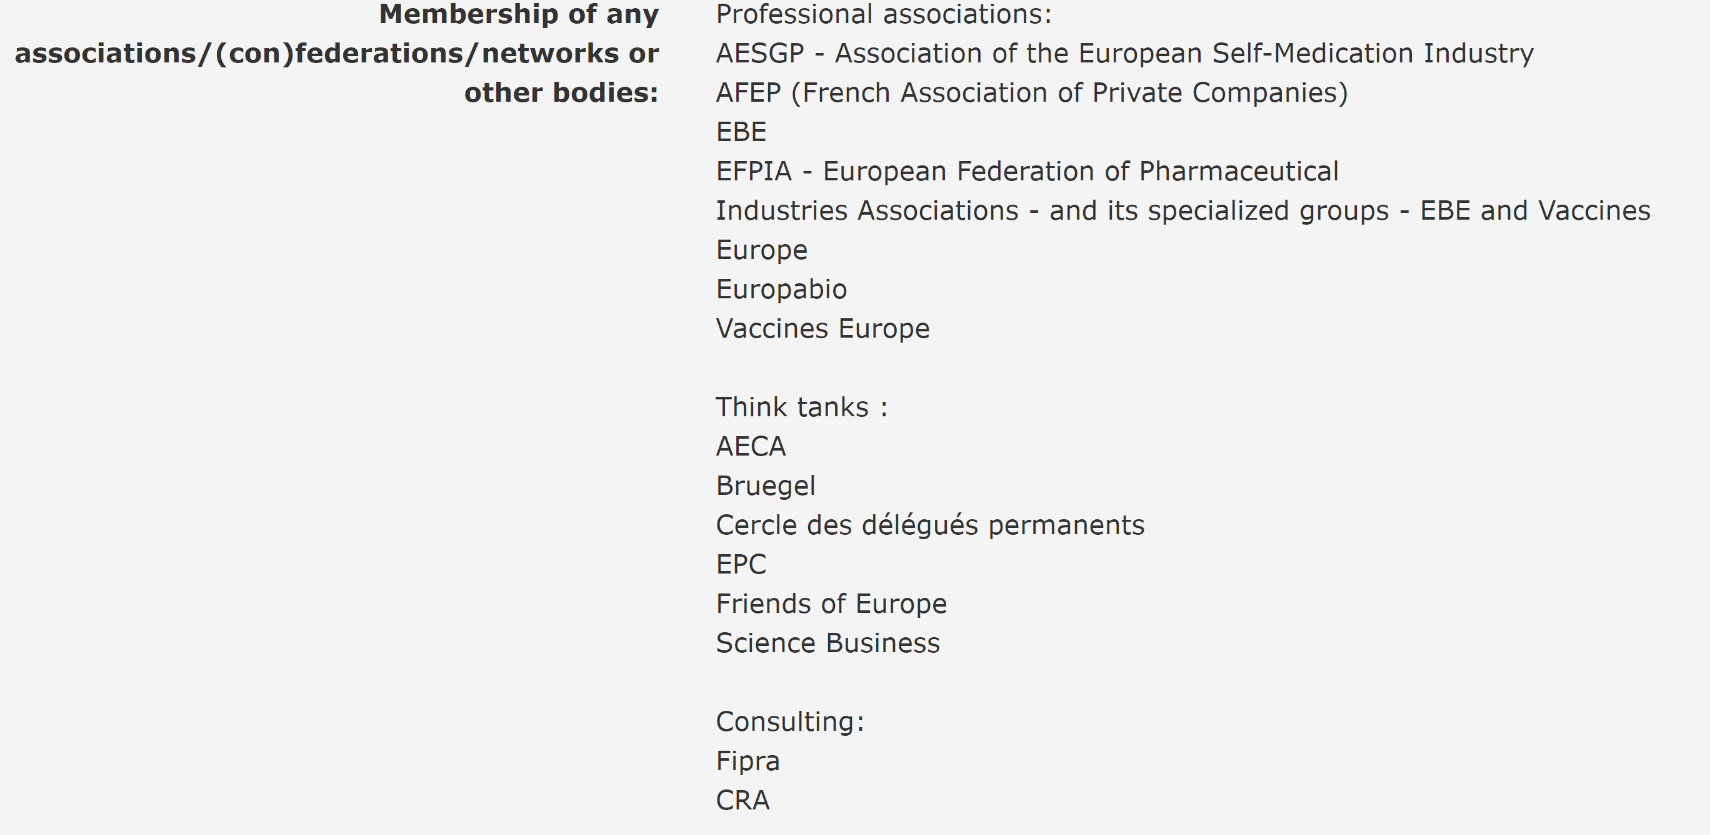
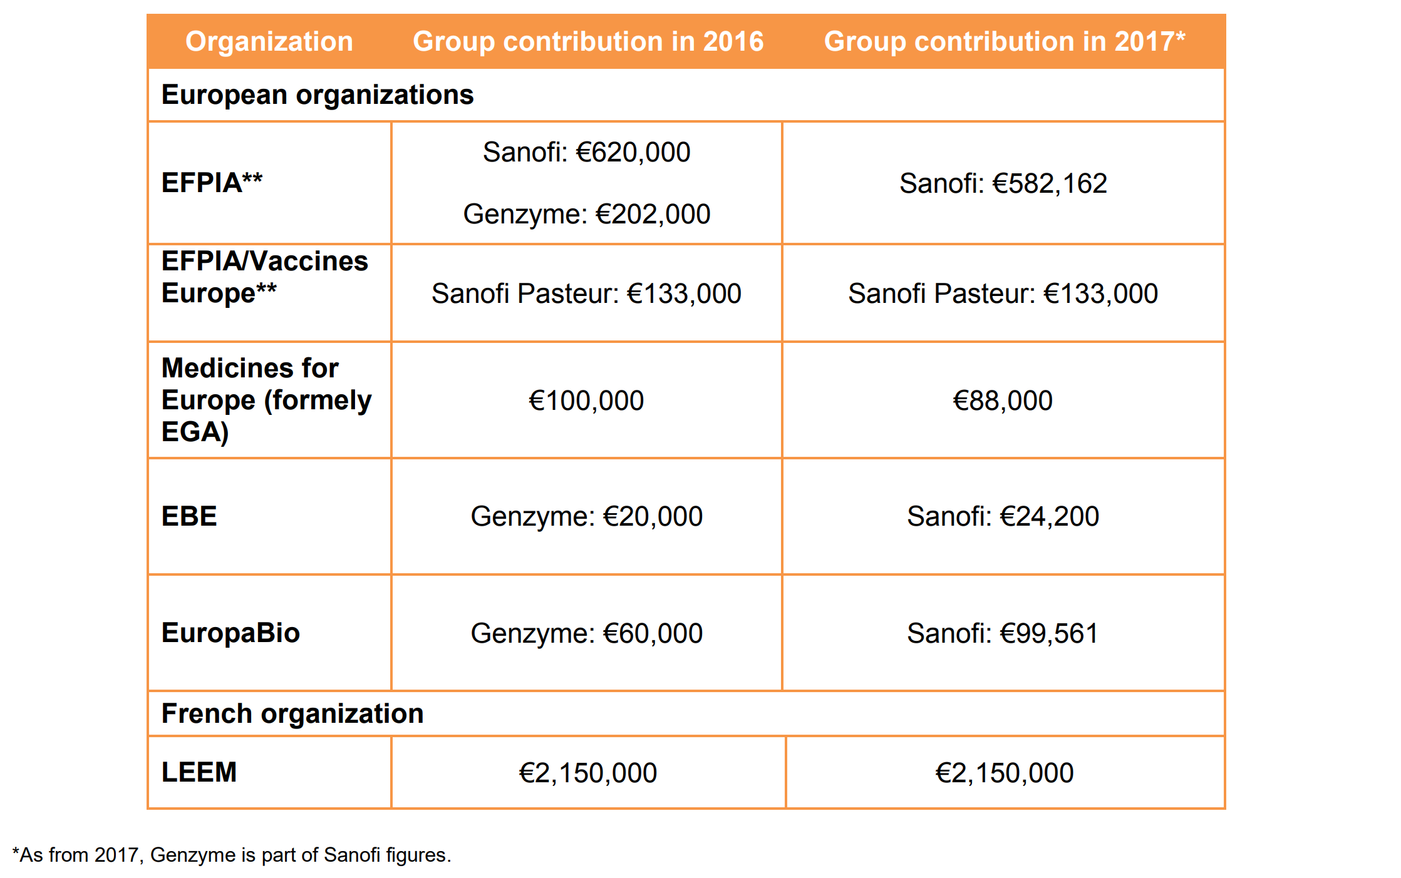
Lobbying through associations and other partners
Sanofi is a member of several industry associations that interact with EU leadership on behalf of companies
In addition, Sanofi works with think tanks and consulting firms in order to accomplish their lobbying goals.
Notes:
Big pharma has a considerable amount of power in EU lobbying, mostly through such as the EFPIA, whose other members include Bayer, Pfizer, and Novartis, among others
The orange table here shows what Sanofi spends on lobbying for a few associations they belong to. Things to note here are that the previously mentioned EFPIA is the largest of the Brussels-based organizations they contribute to during the given years, and the high numbers that they are pumping into the Paris-based organization LEEM, as a result of their national-level goals, which ___ will talk about/has talked about.
https://www.sanofi.com/-/media/Project/One-Sanofi-Web/Websites/Global/Sanofi-COM/Home/common/docs/download-center/Lobbying_2018.pdf?la=en&hash=BFFFFCC15AB7E25A5377B675F9BCADE5A05BDE4C
Here is a list of all of the associations and partners that the EU transparency register can list for Sanofi. Note that this is only a list for Sanofi's partners and associations related to EU lobbying. For US lobbying, Sanofi makes greater use of consulting firms, which will be shown on the next slide.
http://ec.europa.eu/transparencyregister/public/consultation/displaylobbyist.do?id=61291462764-77

Slide 8
Sanofi's US Lobbying
Like in Europe, Sanofi is a member of several industry associations in the US which lobby on behalf of them and other companies
The total 2017 cost of these memberships was 29,156,497 USD
Notes:
Sanofi is a member of over 50 external groups in the United States, including trade associations, think tanks, and local business groups. In addition, Sanofi also made 674,100 USD of direct contributions to political candidates or elected officials. Sanofi has also created a PAC, or Political Action Committee, which allows Sanofi to directly support political candidates that "champion Sanofi and its diverse portfolio."
https://www.sanofi.com/-/media/Project/One-Sanofi-Web/Websites/Global/Sanofi-COM/Home/common/docs/download-center/Lobbying_2018.pdf?la=en&hash=BFFFFCC15AB7E25A5377B675F9BCADE5A05BDE4C
Compared to the two consulting agencies Sanofi uses (or claims to use) in Europe, they reportedly make use of at least 9 for US lobbying. That said, if you were to add up the costs of these 9 agencies, they would not equal the 4,680,000 USD that Sanofi US spends in total for US lobbying, it would only equal 1,655,000. One can conclude that Sanofi US does a lot of in-house lobbying as well, similar to how they operate in Europe.
https://www.opensecrets.org/lobby/clientsum.php?id=D000000215&year=2018&fbclid=IwAR0JMk5AvoNoIAu6DmVEl8wk7pxOaLxmua9Lqz-rQqwvqn6CAWBObTozdP0

Slide 9
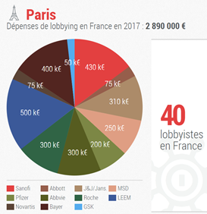
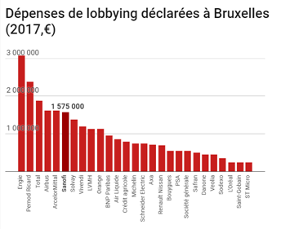
Lobbying budget estimate
The 7th company spending the most to lobby in Washington in 2017.
In Brussels, Sanofi is the fourth company spending the most (with more than 1,500,000 € in 2017)
In Paris, Sanofi is the second pharmaceutical spending the most in lobbying.
More than €10,000,000 to lobby in 2017.
Notes:
IF we compute all expenses of sanofi around the world with its contributions in associations and subsidiaries (described before) : 10,000,000 € in 2017.
Moreover, these calcualtion were based only on the official data. we didn't add on these data all the
Thus, sanofi is one of the company which is spending the most in lobby whole in a year.
https://www.bastamag.net/webdocs/pharmapapers/l-argent-de-l-influence/lobbying-a-paris-bruxelles-et-washington-l-enorme-puissance-de-feu-des-labos/

Slide 10
Bibliography
Lobbying transparency register, 2019 [consulted on 04/14/2019 ]. Available on : http://ec.europa.eu/transparencyregister/public/
Report on the Sanofi lobby, 2019, [consulted on 04/14/2019 ], available on: https://www.sanofi.com/-/media/Project/One-Sanofi-Web/Websites/Global/Sanofi-COM/Home/common/docs/download-center/Lobbying_2018.pdf?la=en&hash=BFFFFCC15AB7E25A5377B675F9BCADE5A05BDE4C
European corporate observatory, 2019, [consulted on 04/14/2019 ]:https://corporateeurope.org/en/power-lobbies/2015/10/transparency-facade-pharma-industry-lobbying-european-commission
Opensecret, newspaper, 2019, [consulted on 04/14/2019],https://www.opensecrets.org/lobby/clientsum.php?id=D000000215&year=2018&fbclid=IwAR0JMk5AvoNoIAu6DmVEl8wk7pxOaLxmua9Lqz-rQqwvqn6CAWBObTozdP0

Slide 11
Bibliography cont.
CBS news, newspaper, 2019, [consulted on 04/14/2019]:https://www.cbsnews.com/news/drug-makers-gave-lobbyists-an-xmas-gift-millions-more-to-lobby-obama-administration/
Cityzen for responsibility and ethics in washington, American government, 2019, [consulted on 04/14/2019]:https://www.citizensforethics.org/a-bitter-pill-how-big-pharma-lobbies-to-keep-prescription-drug-prices-high/
CBS news, newspaper, 2019, [consulted on 04/14/2019]: https://www.cbsnews.com/news/senators-rail-at-big-pharmas-secretive-lobbying/
Observatoire des multinationales, 2019, [consulted on 04/15/2019]: https://www.bastamag.net/webdocs/pharmapapers/l-argent-de-l-influence/a-paris-l-influence-ecrasante-des-labos-face-aux-associations-de-patients/

Slide 12
Bibliography cont.
Observatoire des multinationales, 2019, [consulted on 04/15/2019]: https://www.bastamag.net/webdocs/pharmapapers/l-argent-de-l-influence/lobbying-a-paris-bruxelles-et-washington-l-enorme-puissance-de-feu-des-labos/

