Slide 1
FUEL TAX
ELODIE LEFORT

Slide 2
WHAT IS FUEL tax ?
Tax applicable to most oils with different rates of duty depending on the type of oil with a per litre basis.
Indirect tax
Imposed on fuels which are intended for transportation
used as an ecotax, to promote ecological sustainability

Slide 3
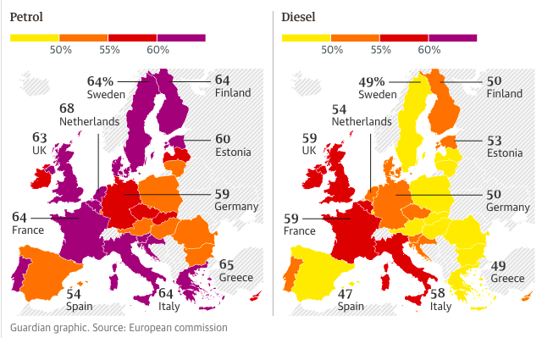
Percentage of fuel taxes on the pump price in 2018

Slide 4
WHY DO WE TAX FUEL ?
to reduce the consumption of these fossil fuels but also to reduce greenhouse gas emissions that result in pollution or congestion
To encourage car makers to produce low-carbon technologies but also to encourage citizens to walk, use public transports or use electric cars
IT generate public revenues
Because of the trading balance

Slide 5
How we discuss the fuel tax in Essca Land :
adding fuel taxes again and again is clearly not a solution to help solving ecological problems, because it only impact the middle class and the lowest one
if we don’t put fuel taxes, everyone will use its cars despite of more ecological transportation and it will not encourage car makers to produce cars more respectfull of the environment

Slide 6
Our solution for the fuel tax in essca land
We will put the fuel taxes as low as possible for the citizens
We will increase taxes for the car constructor depending on the ecological level of the cars they are selling.
Concerning the fuel tax, we will use the same as the border country with the lowest one, for now it’s Spain.

Slide 7
Thank YOU FOR YOUR ATTENTION

