Slide 1
Inheritance Tax
Gilles YAYI
FRANCE

Slide 2
Summary
Inheritance Tax in France
The inventory
Determine the shares
The payment of the tax
Inheritance Tax in Esscaland

Slide 3
Inheritance Tax in France a. The inventory
To calculate the net taxable assets, you must go through the following steps:
Determine an inventory of the deceased's property (gross assets)
Then Subtract the debts (liabilities)
The assets are estimated at their market value on the day of death.
All are the debts are not deductible

Slide 4
Inheritance Tax in France b. calculate the share of each heir
Rules of legal devolution (no testament)

Slide 5
Inheritance Tax in France b. calculate the share of each heir
Rules of legal devolution (no testament)
The details of the share of each in the succession:
If the deceased leaves only children from the couple, the surviving spouse (or husband) has the choice between the following 2 options:
Usufruct of the entire wealth, in this case the children inherit the simple (bare) ownership of the entire estate.
Full ownership of 1/4 of the wealth, the children inherit full ownership of ¾.
If the deceased leaves children from another union, the surviving spouse inherits 1/4 of the wealth in full ownership and the children inherit 3/4 of the wealth in full ownership.

Slide 6
Inheritance Tax in France b. calculate the share of each heir
Rules of legal devolution (no testament)
Definition of Usufruct :
Usufruct is the right to use a property and to receive its income, without being the owner. The usufructuary has rights and obligations. The right to usufruct is temporary.
The full ownership is constituted by the bare ownership and the usufruct.

Slide 7
Inheritance Tax in France b. calculate the share of each heir
Rules of legal devolution (no testament)
If the deceased was not married. His or her children receive all his or her property in equal shares.
If the deceased had no children then, it depends if he was married or not.
If so, then the spouse (or husband) shares the inheritance with the parents, depending on the number of remaining parents. If he had no spouse or children, then his ascendants and brothers and sisters share the inheritance.

Slide 8
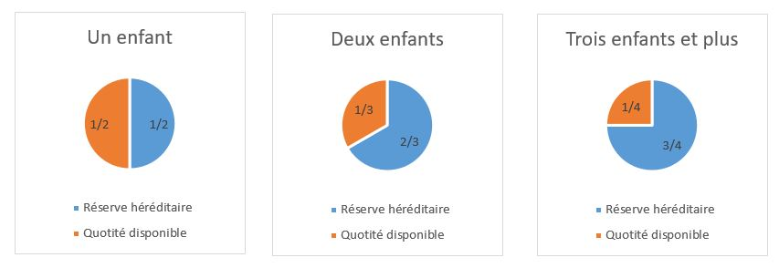
He/She has written a will.
Reserved heirs (Blue) : Some heirs cannot be excluded from the succession. They must receive a share of the deceased's inheritance: this is their reserved portion of the wealth.
Available share (Orange) : It can be distributed freely (to an heir or a third party) by the deceased in his will. The reserved portion of the wealth cannot represents the entirety of the deceased's inheritance.

Slide 9
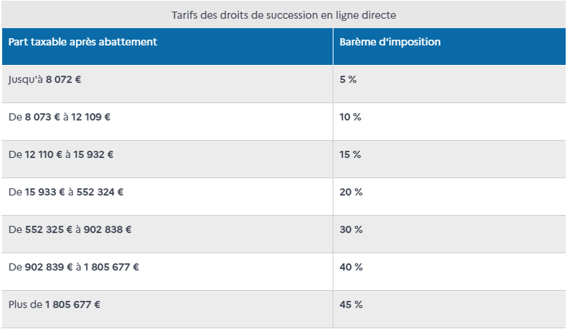
c. The payment of the tax
The tax authorities apply a scale to your share of the wealth, sometimes with an allowance:
Spouse or PACS partner are exempt from inheritance tax.
The tax allowance is €100,000 for the Children

Slide 10
c. The payment of the tax
The tax authorities apply a scale to your share of the wealth, sometimes with an allowance:
The brothers and sisters who benefit from a tax allowance of 15 932 €
The nephews and nieces benefit from an abatement of 7 967 €

Slide 11
2. Inheritance Tax in Esscaland
For me, this tax is an unfair and meaningless tax .
It is necessary to reduce or eliminate it.
I intend to make an inheritance anyway but at a 1%, as it had been decided by the French during the 1789 revolution.
There are countries that have gone as far as abolishing this tax like Austria or Portugal, for me it is the proof that we can do without it.
VAT is a better tax

Slide 12
Thanks for your attention !!
Do you have questions ?

