Slide 1
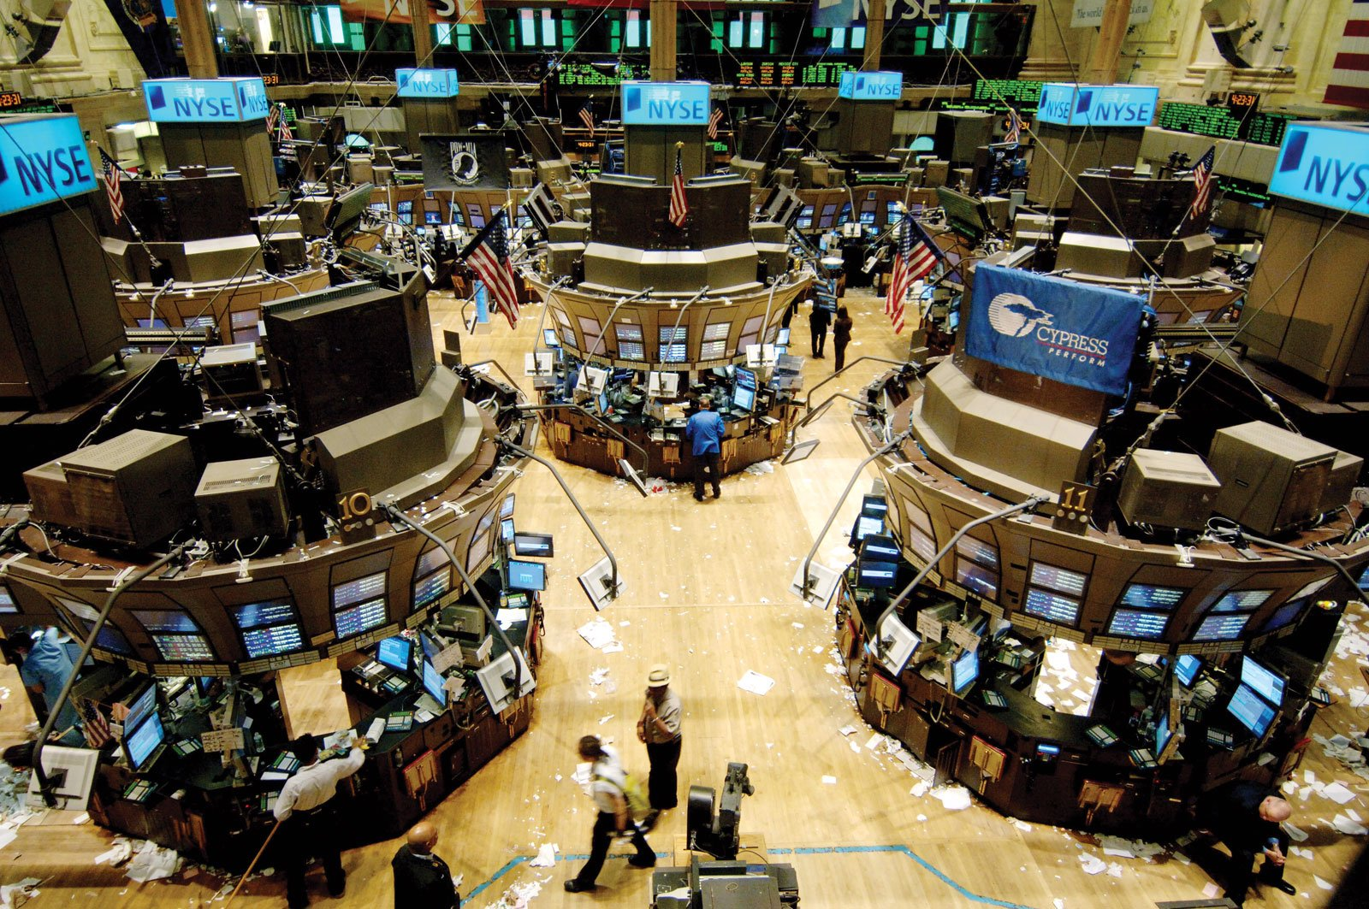
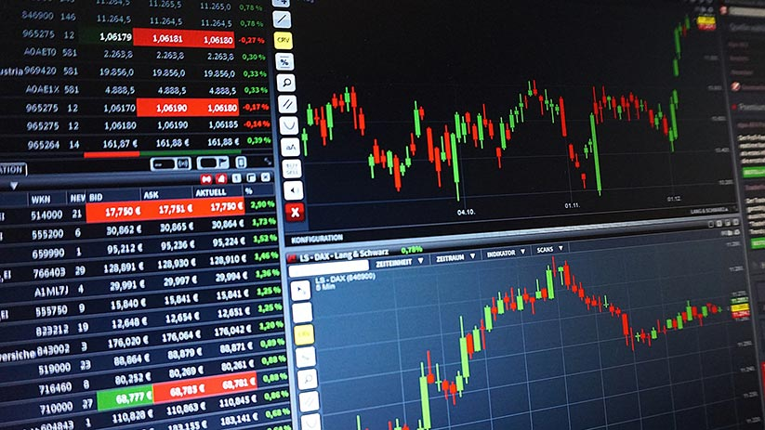
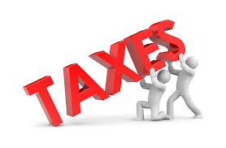
financial transaction tax

Slide 2
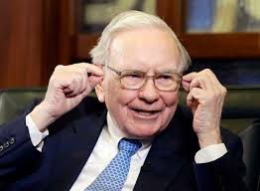
Stock Markets QUickly
The representation of the current value of a company
Type of investors :
Professionals/ Institutionnals individual investors
https://youtu.be/vgqG3ITMv1Q

Slide 3
Presentation of the tax
Intended to regulate the exchanges of shares on the financial markets.
To have control and a view above exchange volumes of stocks.
To Resume : If there is a lot of exchanges in an unexpected moment, il would be preferable to have control above it and dont let bad market makers ruin the actual financial system.

Slide 4
what is the position of other European countries ?
France and Germany are against.
The other part of Europe wants it.

Slide 5
Thank you for listening !

